Slide 1
Sense of Pride
Grace Bundy

Slide 2
5 Ideas
Feminism
  Documentary trailer
  History of women’s pride
Athletes
  How they take pride in what they do
  Short film Documentary
Mental Health
  Swallowing your pride and ask for help
  Short film
Jane Austen
  Taking pride in her work
  Interview style
Celebrities
  Actors in Hollywood
  Interview style

Slide 3
3 Ideas
SWOT Analysis, Moodboards & Target Audience
  Mental Health
    Short film focusing on someone suffering from depression
  Athletes
    Vox popping and interview style documentary on specific athletes
  Celebrities
    Spoken word style documentary linking pride to celebrities

Slide 4
Mental Health
Secondary research
  Statistics on mental health
  NHS website on depression
Contextual Research
  Analysed videos to inspire for my own ideas
Primary Research
  Questionnaire on Google Forms
Storyboard
Colour Grading test shots

Slide 5
Athletes
Primary
  Created a questionnaire on google forms
Secondary
  Chose top 3 athletes and researched into them to help
Interview test shots
  Helped with primary research gather more peoples opinions
Contextual
  Analysed previous work and vox popping video

Slide 6
Celebrities
Primary
  Created a questionnaire to see what celebrities people would want to watch a video about
Secondary
  Researched into the 3 top celebrities that people were interested in to make my decision of which one to choose
Contextual
  Researched existing videos that are similar to what I want the typography to look like
Typography
  Did some typography practice using After Effects after watching Youtube tutorials

Slide 7
Final Idea
After presenting my idea to the class I decided to go with Mental Health because this is the idea that I feel most passionate about. I feel as though that I have a lot more potential with this idea to show off my creativity
I have the most ideas for Mental Health compared to the others and feel as though I can do lots of research to help with the development of this idea
I created a proposal document, and wrote about the context of the project which states the aim of my video, as well as starting a daily log to document my progress

Slide 8


Extended Research
Secondary- Analyzing quotes to gain knowledge and understanding of depression.
In-depth research into living with depression using variety of websites- gain knowledge and better understanding to help convey the illness accurately
“The only thing more exhausting than being depressed is pretending that you’re not.”
"What is depression like? It's like drowning except everyone around you is breathing”

Slide 9
Link to Video
The secondary research that I did helped influence my final idea.
The link that this has to my final video is that it helped me to become more knowledgeable and understanding of what its like to have depression.
It helped to influence my final idea as I realised the severity of mental health which is why I wanted to address the issue.
Made me realise more personal experiences of the what it feels like to have depression.

Slide 10
Extended Research
Primary- Interviewed peers who struggled with depression to find out personal experiences to help develop my idea
  Wanted to find out how they felt, how they coped and the causes
  Incorporate parts of their own stories into him
  Helped influence and inspire my own ideas
I decided to interview my peers who have struggled from Mental Health to find out more personal experiences.
This helped to influence my final video as it helped me to develop my own ideas as to what I wanted to be in the video.
An example of this is that after doing this research my friend said that she always felt tired and weak which lead to the decision for the video to start off with her struggling to get out of bed.

Slide 11
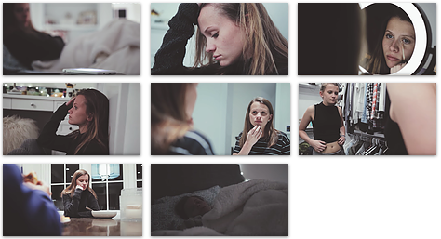
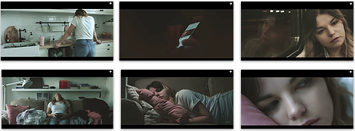
Extended Research
Contextual- Analyzed a few videos to help gain inspiration
  Screenshots of different shots that I thought clearly showed aspects of depression
  Helped to improve and develop my own ideas
After researching into other videos it helped in the development of my own final video.
After watching and analysing them it helped me to make the decision to change my storyline slightly
I saw another video which took a similar approach so I chose this aspect and adapted it so that it fit in more with my idea
Type to enter a caption.

Slide 12
Planning
Potentials & limitations- to see what I need to improve on to make my idea better and to develop it
  Analysed the good and bad parts of my idea to see what I needed to improve and focus more on
Storyboards
  Hand drawn
  Storyboardthat website
  Helped to show my plan of what I wanted the video to look like
Shot List
  Explain what I want to happen in each of the scenes
  Clearer vision of the end product
I did different forms of planning to help with the development of my video.
The storyboards, shot lists and other planning I did helped in the production of the video as I had it to link back to, to make sure that I am on track

Slide 13
Development Reflection
Created a questionnaire focusing on the development I have made since Unit 12
  Helped me realise what I had to do next
  Saw what my peers thought of the developed idea
  Analysed the feedback given

Slide 14
Pre-Production
Filled in the pre-production paperwork necessary
  Budget, Risk assessment, location report, shooting schedule, agreement form
Wrote an improved shot list
  Showed more detail of each scene
Colour grading analysis
  Analysed a Youtube tutorial
Audio
  Researching into different songs that I could use as background music

Slide 15
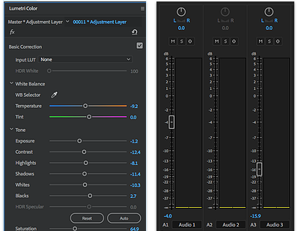
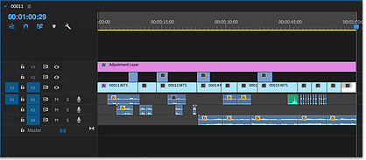
Test Shots
Filmed and edited a section of my idea to see how it would look
  See what I need to improve
  Practiced the colour grading
  Tried out the different background music

Slide 16
Final Video
https://youtu.be/Bod0hznTYHU

